Slide 1
Use Cases Diagram
Session 17
(Tutorial)
Course : Program Design Methods
Effective Period : July 2018

Slide 2
These slides have been adapted from
Britton, C.. (2005). A student Guide to Object Oriented Development. 01. Butterworth-Heinemann. Amsterdam. ISBN: 978-0-7506-6123-2. Chapter 3
Acknowledgement

Slide 3
LO 1 : Explain program design method
LO 2 : Apply the process of program developing
LO 3 : Design the application using program design method
LO 4 : Demonstrate the use of program design method
LO 5 : Explain the object oriented design
Learning Objectives

Slide 4
Contents
Introduction
Use Case Diagram
Use Case Description
Actors and Actor Description
Use Case Relationship
Boundary

Slide 5
Introduction
Use case model the user’s view of functionality of a system
The use case model provide a means of organizing, structuring, and documenting the mass of information during requirement elicitation

Slide 6
Use Case Diagram
The use case model consist of a use case diagram, a set of use case description and a set of scenarios
The use case diagram models the problem domain graphically using four concepts : the use case, the actor, the relationship link and the boundary.

Slide 7
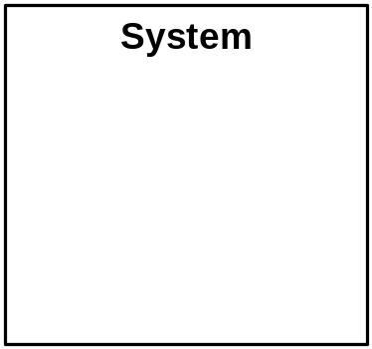
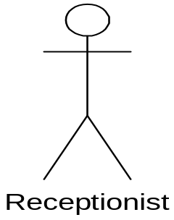
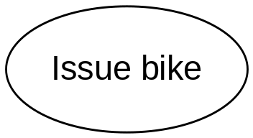
Use Case Diagram
A Use case : an
ellipse labeled
with the name
of the use case
An actor : a stick
figure labeled
with the name of
the actor. The
stick figure icon is
used even when
the actor is non
human, e.g an
organization
A use case
relationship : a
line linking an
actor to a use
case. This
relationship is
also known as a
Communication
association
The boundary : a
line drawn round
the use cases to
separate them
from the actors
and to delineate
the area of
interest

Slide 8
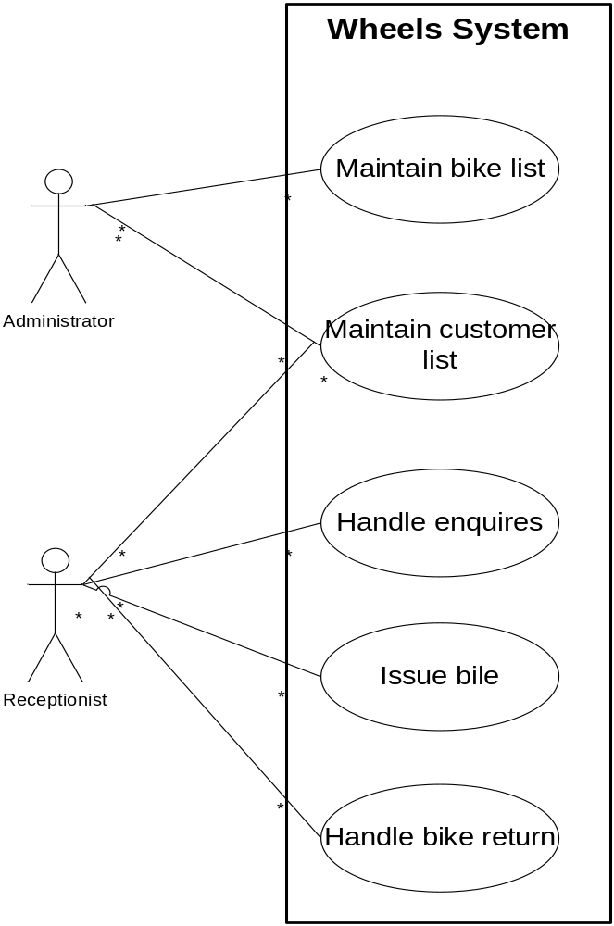
Example
The functionality of the new system has been divided into five use cases :’Maintain bike list’, ‘Maintain customer list’, ‘Handle enquires’, ‘Issue bike’, and ‘Handle bike return’
The actor, represented by a stick figure, is the person who uses the system in the way specified in the use case

Slide 9
The Use Case
There are two ways of identifying the use case
  Identifying use cases from the actors
    Identify the actors, the users of the system, and for each one, to establish how they use the system, what they use it to achieve
  Identifying use cases from scenarios
    Scenarios describes a series of interactions between the user and the system in order to achieve a specified goal. A scenario describe a specific sequence of events.

Slide 10
Use Case Descriptions
The use case description is a narrative document that describes, in general terms, the required functionality of the use case. Typically it describes the use case goal and gives a general description of what usually happens, the normal course of events, adding a brief description of any minor variations
The use case descriptions can be categorized into two
  High level description : these description need only document the purpose of the use case , the actor involved and give general overview of what happens
  Expanded use case : this description is more detailed and structured that the high level use case description. It should document : what happens to initiate the use case, which actors are involved, which data has to be input, the use case output, what stored data is needed by the use case, what happens to signal the completion of the use case, minor variation in the sequences events

Slide 11
Actors and Actor description
Actor :
  Is someone who inputs information to the system or receive information from it
  An actor represents a particular way of using the system; a way of interacting with the system to achieve a use case goal
Actors are identified by asking such question as :
  Who is involved in major system processes such as issuing bikes ?
  Who will use the new system?
  Who supplies information to the system ?
  Who will receive output from the system ?

Slide 12
Use Case relationship
Type of use case relationship
  Communication association :
    Represent by the line linking an actor to a use case
    Shows with actors are associated with which use case
    Each actor may be associated with many use cases and each use case may be associated with many actors
  Include
    Is useful where there is a chunk of behaviour that is common to several use cases
    Rather than repeat a description of that behaviour in several use case description, the common behaviour can be split off into a separate use case which is then linked to all relavant use cases with an <<include>> relationship
  Extend
    Is used as way of specifying significant alternative behaviour in a use case
    It usually documents functionality that the user can opt to use over and about the norm

Slide 13
Boundary
Boundary
  It is shown as a line round the use cases, separating them from the actors, normally it is labaled with the name of the system or subsystem.

Slide 14
References
Britton, C.. (2005). A student Guide to Object Oriented Development. 01. Butterworth-Heinemann. Amsterdam. ISBN: 978-0-7506-6123-2.
UML, http://www.apl.jhu.edu/Classes/Notes/Demasco/605704/UMLIntroduction.pdf
Use Case Diagram, http://www.objectmentor.com/resources/articles/usecases.pdf

Slide 15
Q & A

Slide 16
Exercise
Your local railway station is going to install automatic ticket dispensing machines. Each machine will be able to give passengers up-to-date train timetable and ticket price information. The machines must also issue tickets and transfer statistics about ticket sales to a central computer system. Railway staff must be able to update ticket prices and timetable information.
Draw a use case diagram to model what the ticket machines must do.

